Slide 1
Classification
Part-2
CME 4416 – Introduction to Data Mining

Slide 2

Outline
Introduction to Bayesian Learning
Features of Bayesian Learning
Probability Theory
Bayes Theory
Bayesian Classification
Bayesian Learning Examples
Classifier Evaluation Metrics
K-Nearest Neighbor Classification

Slide 3
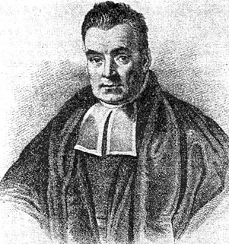
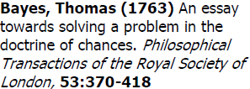
Who is he?

Slide 4
Supervised Learning
Learning
Supervised Learning
Unsupervised Learning
Classification
Clustering
Decision Tree Learning
Association Analysis
Bayesian Learning
Sequence Analysis
Nearest Neighbour
Summerization
Neural Networks
Descriptive Statistics
Support Vector Machines
Outlier Analysis
Regression
Scoring

Slide 5
Bayesian Learning
Bayesian learning formulates learning as a form of probabilistic inference, using the observations to update a prior distribution over hypotheses.
Calculates the probability of each hypothesis, given the data.
It then makes predictions using all hypotheses weighted by their probabilities (instead of a single best hypothesis).
Learning is reduced to probabilistic inference.

Slide 6
Bayesian Learning
Bayesian learning algorithms are among the most practical approaches to certain type of learning problems
They provide a useful perspective for understanding many learning algorithms that do not explicitly manipulate probabilities

Slide 7
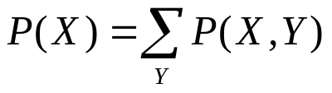
Probabilities
Have two dice h₁ and h₂
The probability of rolling an i given die h₁ is denoted P(i|h₁). This is a conditional probability
Pick a die at random with probability P(h_{j}), j=1 or 2. The probability for picking die h_{j} and rolling an i with it is called joint probability and is P(i, h_{j})=P(h_{j})P(i| h_{j}).
For any events X and Y, P(X,Y)=P(X|Y)P(Y)
If we know P(X,Y), then the so-called marginal probability P(X) can be computed as

Slide 8
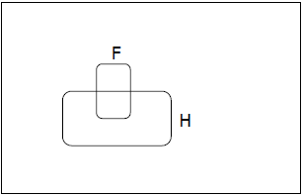
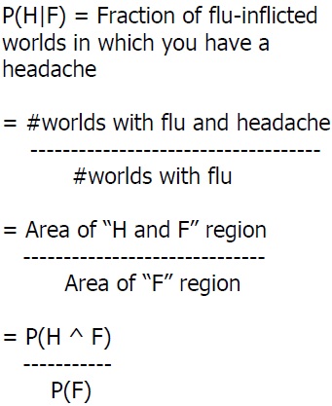
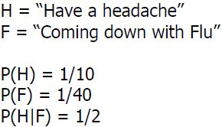
Conditional Probability Example

Slide 9
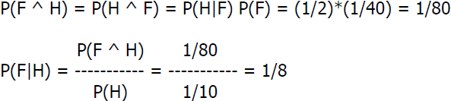
Probabilistic Inference

Slide 10
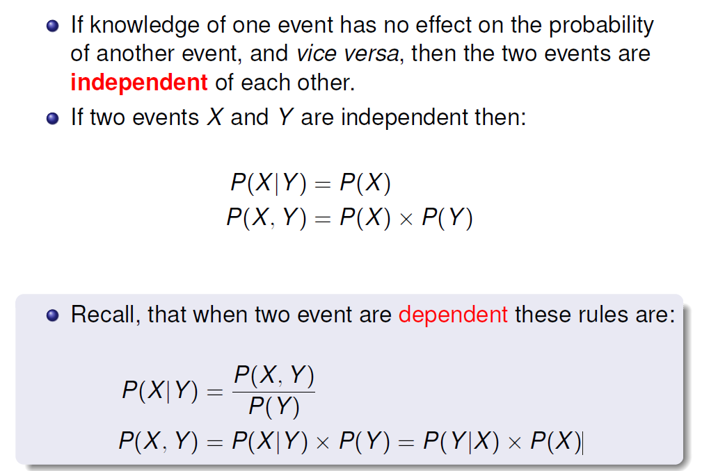


Slide 11
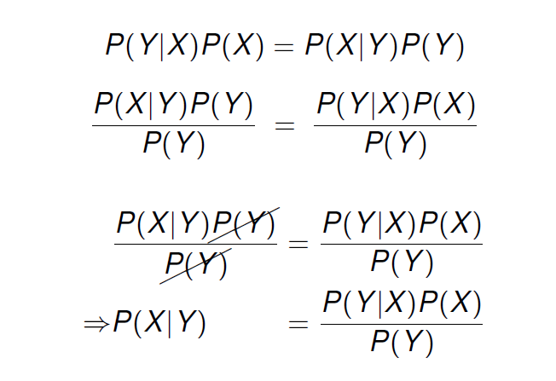
A Naive Bayes’ classifier naively assumes that each of the descriptive features in a domain is conditionally independent of all of the other descriptive features, given the state of the target feature.

Slide 12
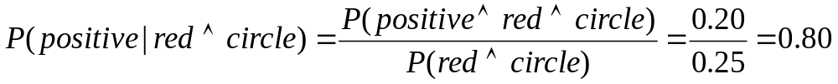
Joint Distribution
The joint probability distribution for a set of random variables, X₁,…,X_{n} gives the probability of every combination of values: P(X₁,…,X_{n})
The probability of all possible conjunctions can be calculated by summing the appropriate subset of values from the joint distribution.
Therefore, all conditional probabilities can also be calculated.
positive
negative
 | circle | square
red | 0.20 | 0.02
blue | 0.02 | 0.01
 | circle | square
red | 0.05 | 0.30
blue | 0.20 | 0.20

Slide 13
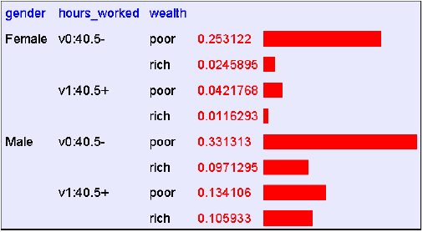
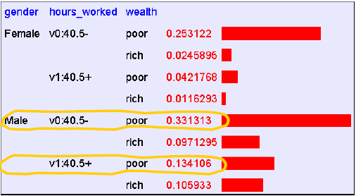

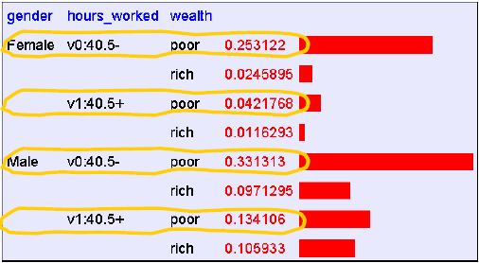

Joint Distribution Example

Slide 14
Bayes Theorem
Bayes theorem plays a critical role in probabilistic learning and classification.
Build a generative model that approximates how data is produced
Uses prior probability of each category given no information about an item.
Categorization produces a posterior probability distribution over the possible categories given a description of an item.

Slide 15
Bayes Theorem
Goal: To determine the most probable hypothesis, given the data D plus any initial knowledge about the prior probabilities of the various hypotheses in H.
Prior probability of h, P(h): it reflects any background knowledge we have about the chance that h is a correct hypothesis (before having observed the data).
Prior probability of D, P(D): it reflects the probability that training data D will be observed given no knowledge about which hypothesis h holds.
Conditional Probability of observation D, P(D|h): it denotes the probability of observing data D given some world in which hypothesis h holds.
Posterior probability of h, P(h|D): it represents the probability that h holds given the observed training data D. It reflects our confidence that h holds after we have seen the training data D and it is the quantity that Machine Learning researchers are interested in.
Likelihood
Prior
P(D|h) P(h)
P(h|D) =
P(D)
Posterior

Slide 16
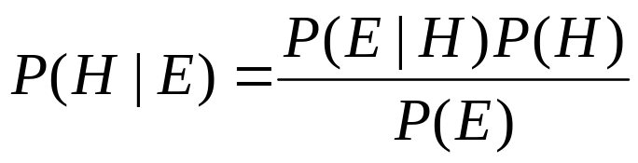
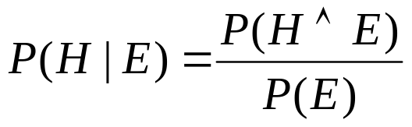
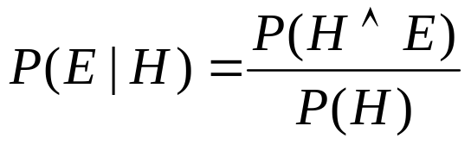

Proof
Simple proof from definition of conditional probability:
(Def. cond. prob.)
(Def. cond. prob.)
QED:

Slide 17
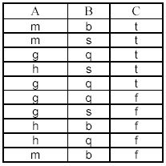
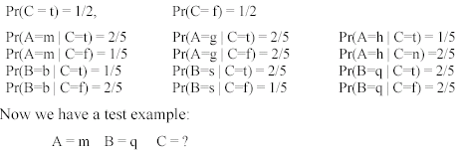
An example
Compute all probabilities required for classification

Slide 18
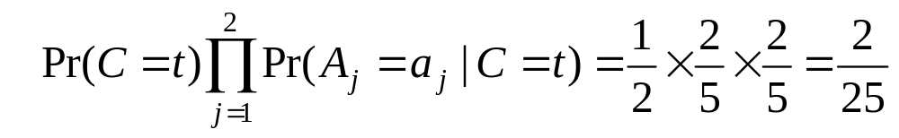
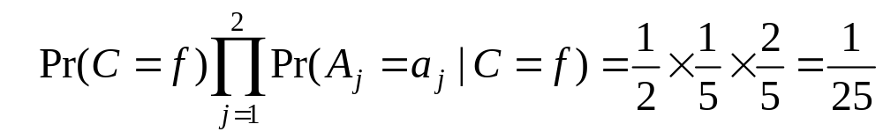
An Example (cont …)
For C = t, we have
For class C = f, we have
C = t is more probable. t is the final class.

Slide 19
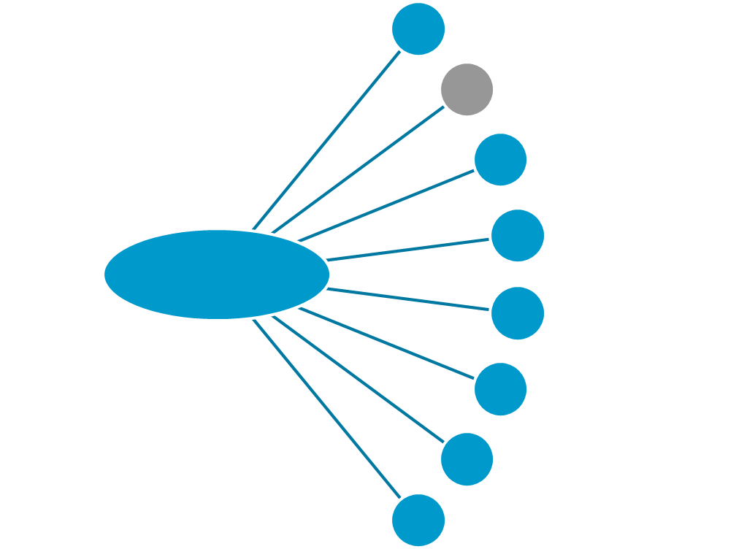
Classification Techniques
Decision Trees
Bayesian Classification
K-Nearest Neighbor
Neural Network
Classification
Genetic Algorithms
Support Vector Machines (SVM)
Fuzzy Set Approaches
Rough Set Approach

Slide 20
Bayesian Classification
We can design a classifier from a training sample
  No problem with prior estimation
  Samples are often small for class-conditional estimation
We use p(C_{i} | D) for our classification rule
Estimation is an identical procedure for all classes

Slide 21
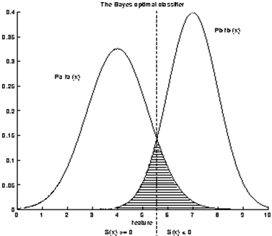
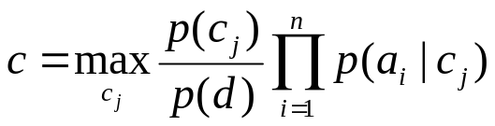
Bayesian Classification
If P(C_{i}|D) is greater than other P(C_{k}|D) values then data D belongs to class C_{i}
Find all probabilities for each class
Select the maximum probability

Slide 22
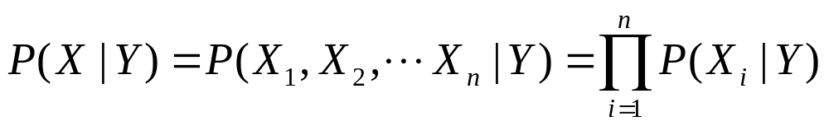
Naïve Bayesian Categorization
If we assume features of an instance are independent given the category (conditionally independent).
Therefore, we then only need to know P(X_{i} | Y) for each possible pair of a feature-value and a category.
If Y and all X_{i} and binary, this requires specifying only 2n parameters:
  P(X_{i}=true | Y=true) and P(X_{i}=true | Y=false) for each X_{i}
  P(X_{i}=false | Y) = 1 – P(X_{i}=true | Y)
Compared to specifying 2^{n} parameters without any independence assumptions.

Slide 23
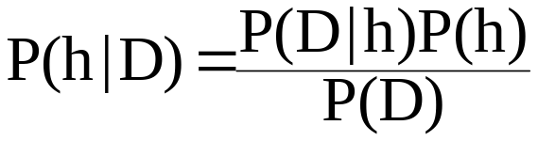
Bayesian Classification
D Veri örneği. Sınıf etiketi bilinmiyor
H Hipotez: D C sınıfına aittir
P(H|D) D veri örneği için H hipotezinin olma ihtimali
(sonraki olasılık) (posteriori probability)
P(H) (önceki olasılık) (prior probability)
Herhangi bir örneğin C sınıfına ait olma olasılığı
P(D) D’in olma olasılığı
P(D|H) Hipotezin tutması durumunda D’in olma olasılığı (likelihood)

Slide 24
Bayesian Classification Example
D Veri örneği. Sınıf etiketi bilinmiyor
(yaş: <=30 yıl : 2 cinsiyet : bay şube : izmir )
H Hipotez: D, DE Yoğurt satın alır
P(H|D) D kişisinin DE Yoğurt satın alma ihtimali
P(H) Herhangi bir örneğin DE Yoğurt alacaklar sınıfına ait
olma olasılığı
P(D) Veri setindeki herhangi bir insanın genç, 2 yıl üye,
bay ve İzmir’de yaşama olasılığı
P(D|H) D’in DE Yoğurt alacaklar sınıfında olduğu biliniyor,
D’in genç, 2 yıl üye, bay, İzmirli olma olasılığı

Slide 25
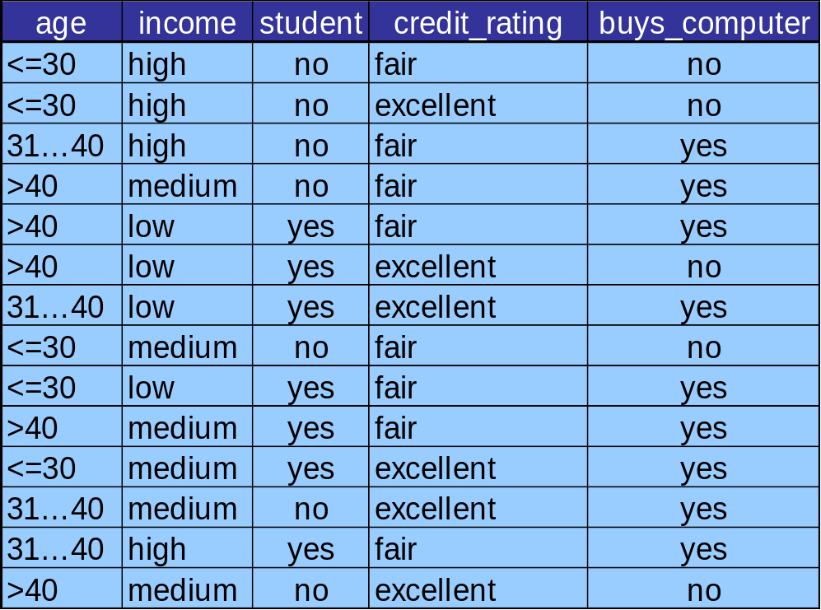
Example - Buy Computer?
Class:
C1:buys_computer = ‘yes’
C2:buys_computer = ‘no’
Data sample
X = (Age <=30,
Income = medium,
Student = yes
Credit_rating = Fair)

Slide 26
Example - Buy Computer?
X = (age <= 30 , income = medium, student = yes, credit_rating = fair)
P(C₁): P(buys_computer = “yes”) = 9/14 = 0.643
P(C₂): P(buys_computer = “no”) = 5/14= 0.357
Compute P(X|C_{i}) for each class
P(age = “<=30” | buys_computer = “yes”) = 2/9 = 0.222
P(age = “<= 30” | buys_computer = “no”) = 3/5 = 0.6
P(income = “medium” | buys_computer = “yes”) = 4/9 = 0.444
P(income = “medium” | buys_computer = “no”) = 2/5 = 0.4
P(student = “yes” | buys_computer = “yes) = 6/9 = 0.667
P(student = “yes” | buys_computer = “no”) = 1/5 = 0.2
P(credit_rating = “fair” | buys_computer = “yes”) = 6/9 = 0.667
P(credit_rating = “fair” | buys_computer = “no”) = 2/5 = 0.4
P(X|C₁) : P(X|buys_computer = “yes”) = 0.222 x 0.444 x 0.667 x 0.667 = 0.044
P(X|C₂) : P(X|buys_computer = “no”) = 0.6 x 0.4 x 0.2 x 0.4 = 0.019
P(X|C_{i})*P(C_{i}) : P(X|buys_computer = “yes”) * P(buys_computer = “yes”) = 0.028
P(X|buys_computer = “no”) * P(buys_computer = “no”) = 0.007
Therefore, X belongs to class (“buys_computer = yes”)

Slide 27
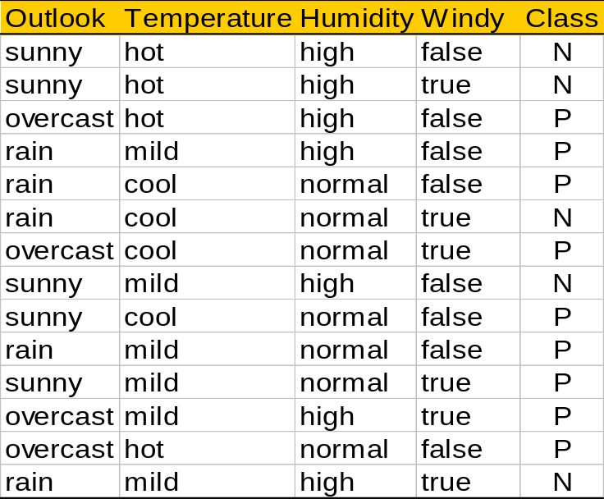
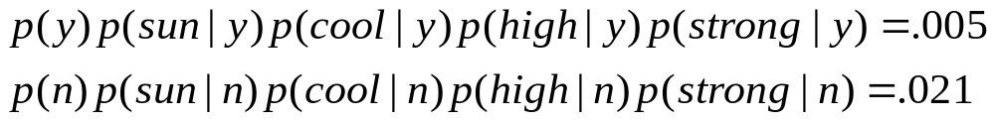
Example - Play Tennis?
outlook
P(sunny|p) = 2/9 | P(sunny|n) = 3/5
P(overcast|p) = 4/9 | P(overcast|n) = 0
P(rain|p) = 3/9 | P(rain|n) = 2/5
temperature
P(hot|p) = 2/9 | P(hot|n) = 2/5
P(mild|p) = 4/9 | P(mild|n) = 2/5
P(cool|p) = 3/9 | P(cool|n) = 1/5
humidity
P(high|p) = 3/9 | P(high|n) = 4/5
P(normal|p) = 6/9 | P(normal|n) = 2/5
windy
P(true|p) = 3/9 | P(true|n) = 3/5
P(false|p) = 6/9 | P(false|n) = 2/5
P(p) = 9/14
P(n) = 5/14
<sunny, cool, high, strong>

Slide 28
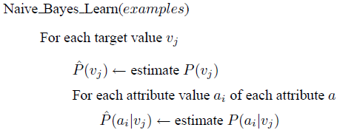

Naive Bayes Algorithm

Slide 29
Naïve Bayes Example
Probability | positive | negative
P(Y) | 0.5 | 0.5
P(small | Y) | 0.4 | 0.4
P(medium | Y) | 0.1 | 0.2
P(large | Y) | 0.5 | 0.4
P(red | Y) | 0.9 | 0.3
P(blue | Y) | 0.05 | 0.3
P(green | Y) | 0.05 | 0.4
P(square | Y) | 0.05 | 0.4
P(triangle | Y) | 0.05 | 0.3
P(circle | Y) | 0.9 | 0.3
Test Instance:
<medium ,red, circle>
med
red
circ
lg
red
circ
sm
blue
tri
tri
sm
blue
sqr
med
lg
red
grn
red
circ
med
med
grn
grn
tri
circ
lg
lg
sm
blue
circ
circ
sm
lg
red
blue
circ
tri
sqr
sm
med
red
red
circ
sqr
sm
lg
blue
grn
sqr
tri
Size Color Shape
Size Color Shape
Positive
Negative

Slide 30
Naïve Bayes Example
Probability | positive | negative
P(Y) | 0.5 | 0.5
P(medium | Y) | 0.1 | 0.2
P(red | Y) | 0.9 | 0.3
P(circle | Y) | 0.9 | 0.3
Test Instance:
<medium ,red, circle>
P(positive | X) = P(positive)*P(medium | positive)*P(red | positive)*P(circle | positive) / P(X)
0.5 * 0.1 * 0.9 * 0.9
= 0.0405 / P(X)
= 0.0405 / 0.0495 = 0.8181
P(negative | X) = P(negative)*P(medium | negative)*P(red | negative)*P(circle | negative) / P(X)
0.5 * 0.2 * 0.3 * 0.3
= 0.009 / P(X)
= 0.009 / 0.0495 = 0.1818
P(positive | X) + P(negative | X) = 0.0405 / P(X) + 0.009 / P(X) = 1
P(X) = (0.0405 + 0.009) = 0.0495

Slide 31
Probability Estimation Example
Probability | positive | negative
P(Y) | 0.5 | 0.5
P(small | Y) | 0.5 | 0.5
P(medium | Y) | 0.0 | 0.0
P(large | Y) | 0.5 | 0.5
P(red | Y) | 1.0 | 0.5
P(blue | Y) | 0.0 | 0.5
P(green | Y) | 0.0 | 0.0
P(square | Y) | 0.0 | 0.0
P(triangle | Y) | 0.0 | 0.5
P(circle | Y) | 1.0 | 0.5
Ex | Size | Color | Shape | Category
1 | small | red | circle | positive
2 | large | red | circle | positive
3 | small | red | triangle | negitive
4 | large | blue | circle | negitive
Test Instance X:
<medium, red, circle>
P(positive | X) = 0.5 * 0.0 * 1.0 * 1.0 / P(X) = 0
P(negative | X) = 0.5 * 0.0 * 0.5 * 0.5 / P(X) = 0

Slide 32

Laplace Corrections
In the absence of any evidence, we expect to multiply by zero
So the result will be zero

Slide 33
Laplace Correction Example
Assume training set contains 10 positive examples:
  4: small
  0: medium
  6: large
Estimate parameters as follows (if m=1, p=1/3)
  P(small | positive) = (4 + 1/3) / (10 + 1) = 0.394
  P(medium | positive) = (0 + 1/3) / (10 + 1) = 0.03
  P(large | positive) = (6 + 1/3) / (10 + 1) = 0.576
  P(small or medium or large | positive) = 1.0

Slide 34
Laplace Correction Example
Age groups: <=30 (500 persons)
31..40 (250 persons)
41..60 (50 persons)
>60 (0 person)
Laplacian Correction
  Prob(age = “<=30”) = 501 / 804
  Prob(age = “31..40”) = 251 / 804
  Prob(age = “41..60”) = 51 / 804
  Prob(age = “>60”) = 1 / 804

Slide 35
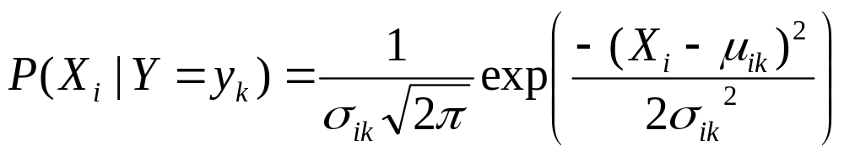
Continuous Attributes
If X_{i} is a continuous feature rather than a discrete one, need another way to calculate P(X_{i} | Y).
Assume that X_{i} has a Gaussian distribution whose mean and variance depends on Y.
During training, for each combination of a continuous feature X_{i} and a class value for Y, y_{k}, estimate a mean, μ_{ik} , and standard deviation σ_{ik} based on the values of feature X_{i} in class y_{k} in the training data.
During testing, estimate P(X_{i} | Y=y_{k}) for a given example, using the Gaussian distribution defined by μ_{ik} and σ_{ik} .

Slide 36
Why Bayesian?
Provides practical learning algorithms
Prior knowledge and observed data can be combined
It is a generative (model based) approach, which offers a useful conceptual framework
  E.g. sequences could also be classified, based on a probabilistic model specification
  Any kind of objects can be classified, based on a probabilistic model specification

Slide 37
Features of Bayesian Learning
Each training example can incrementally decrease or increase the estimated probability that a hypothesis is correct
Prior knowledge can be combined with observed data to determine the final probability of a hypothesis
Hypotheses with probabilities can be accommodated
New instances can be classified by combining multiple hypotheses weighted by their probabilities

Slide 38
Classifier Evaluation Metrics:
Confusion Matrix
Confusion Matrix:
Actual class\Predicted class | C₁ | ¬ C₁
C₁ | True Positives (TP) | False Negatives (FN)
¬ C₁ | False Positives (FP) | True Negatives (TN)
Example of Confusion Matrix:
Actual class\Predicted class | buy_computer = yes | buy_computer = no | Total
buy_computer = yes | 6954 | 46 | 7000
buy_computer = no | 412 | 2588 | 3000
Total | 7366 | 2634 | 10000
Given m classes, an entry, CM_{i,j} in a confusion matrix indicates # of tuples in class i that were labeled by the classifier as class j
May have extra rows/columns to provide totals

Slide 39
Classifier Evaluation Metrics: Accuracy, Error Rate, Sensitivity and Specificity
A\P | C | ¬C
C | TP | FN | P
¬C | FP | TN | N
 | P’ | N’ | All
Class Imbalance Problem:
  One class may be rare, e.g. fraud, or HIV-positive
  Significant majority of the negative class and minority of the positive class
  Sensitivity: True Positive recognition rate
    Sensitivity = TP/(TP+FN)
  Specificity: True Negative recognition rate
    Specificity = TN/(TN+FP)
Classifier Accuracy, or recognition rate: percentage of test set tuples that are correctly classified
  Accuracy = (TP + TN)/All
Error rate: 1 – accuracy, or
  Error rate = (FP + FN)/All

Slide 40



Classifier Evaluation Metrics:
Precision and Recall, and F-measures
Precision: exactness – what % of tuples that the classifier labeled as positive are actually positive
Recall: completeness – what % of positive tuples did the classifier label as positive?
Perfect score is 1.0
Inverse relationship between precision & recall
F measure (F₁ or F-score): harmonic mean of precision and recall,

Slide 41
Classifier Evaluation Metrics: Example
Actual Class\Predicted class | cancer = yes | cancer = no | Total | Recognition(%)
cancer = yes | 90 | 210 | 300 | 30.00 (sensitivity
cancer = no | 140 | 9560 | 9700 | 98.56 (specificity)
Total | 230 | 9770 | 10000 | 96.40 (accuracy)
  Precision = 90/230 = 39.13% Recall = 90/300 = 30.00%

Slide 42
Training/Test Split
Randomly split dataset into two parts:
  Training data
  Test data
Use training data to optimize parameters
Evaluate error using test data
After training save model to use future
    Classification accuracy depends upon the dimensionality and the amount of training data

Slide 43
Evaluating Classifier Accuracy:
Holdout & Cross-Validation Methods
Holdout method
  Given data is randomly partitioned into two independent sets
    Training set (e.g., 2/3) for model construction
    Test set (e.g., 1/3) for accuracy estimation
  Random sampling: a variation of holdout
    Repeat holdout k times, accuracy = avg. of the accuracies obtained
Cross-validation (k-fold, where k = 10 is most popular)
  Randomly partition the data into k mutually exclusive subsets, each approximately equal size
  At i-th iteration, use D_{i} as test set and others as training set
  Leave-one-out: k folds where k = # of tuples, for small sized data
  *Stratified cross-validation*: folds are stratified so that class dist. in each fold is approx. the same as that in the initial data

Slide 44
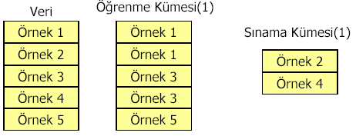

Validation Techniques
Simple Validation
Cross Validation
n-Fold Cross Validation
Training set
Test set
Training set
Test set
Test set
Training set
Bootstrap Method

Slide 45
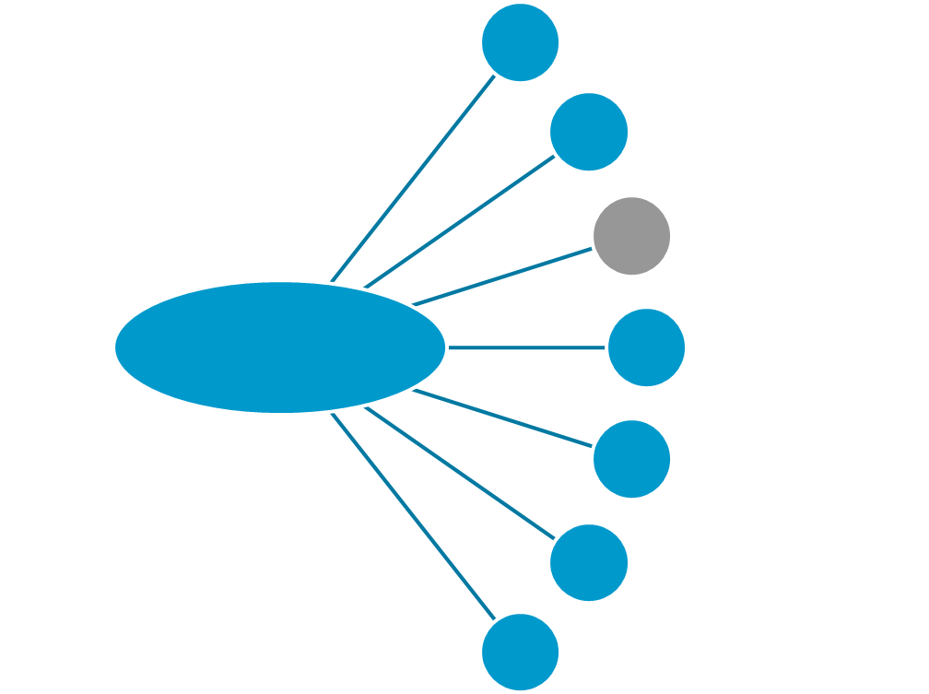
Classification Techniques
Decision Trees
Bayesian Classification
K-Nearest Neighbor
Classification
Neural Network
Support Vector Machines (SVM)
Fuzzy Set Approaches
…

Slide 46
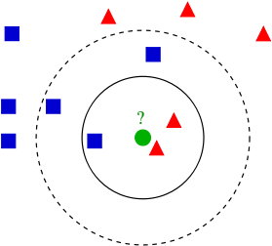
K-Nearest Neighbor (k-NN)
An object is classified by a majority vote of its neighbors (k closest members) .
If k = 1, then the object is simply assigned to the class of its nearest neighbor.
Euclidean Distance measure is used to calculate how close

Slide 47
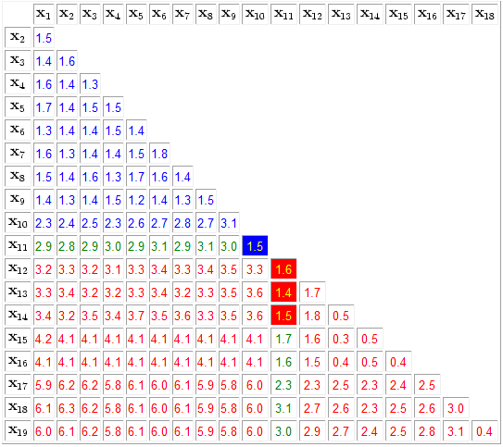
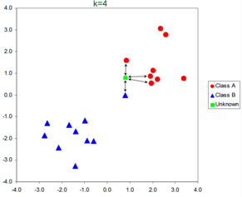
K-Nearest Neighbor (k-NN)

Slide 48
Lazy Lerners
The classification methods discussed so far —decision tree induction, Bayesian classification are all examples of eager learners.
Eager learners, when given a set of training tuples, will construct a generalization (i.e., classification) model before receiving new (e.g., test) tuples to classify. We can think of the learned model as being ready and eager to classify previously unseen tuples.
Imagine a contrasting lazy approach, in which the learner instead waits until the last minute before doing any model construction to classify a given test tuple.
That is, when given a training tuple, a lazy learner simply stores it (or does only a little minor processing) and waits until it is given a test tuple. Only when it sees the test tuple does it perform generalization to classify the tuple based on its similarity to the stored training tuples.

Slide 49

Distance Metric
Nearest-neighbor classifiers are based on learning by analogy, that is, by comparing a given test tuple with training tuples that are similar to it. The training tuples are described by n attributes. When given an unknown tuple, a k-nearest-neighbor classifier searches the pattern space for the k training tuples that are closest to the unknown tuple. These k training tuples are the k “nearest neighbors” of the unknown tuple.
“Closeness” is defined in terms of a distance metric, such as Euclidean distance.

Slide 50
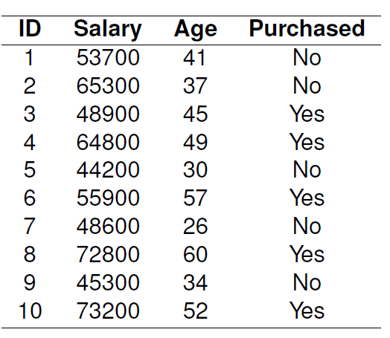

Normalization
Typically, we normalize the values of each attribute before using Equation below.
This helps prevent attributes with initially large ranges (e.g., salary) from outweighing attributes with initially smaller ranges (e.g., age attributes).Min-max normalization, for example, can be used to transform a value v of a numeric attribute A to v 0 in the range [0, 1] by computing:

Slide 51
Continuous Target?
Nearest-neighbor classifiers can also be used for numeric prediction, that is, to return a real-valued prediction for a given unknown tuple.
In this case, the classifier returns the average value of the real-valued labels associated with the k-nearest neighbors of the unknown tuple.

Slide 52
Categorical Attributes?
For nominal attributes, a simple method is to compare the corresponding value of the attribute in tuple X1 with that in tuple X2.
If the two are identical (e.g., tuples X1 and X2 both have the color blue), then the difference between the two is taken as 0.
If the two are different (e.g., tuple X1 is blue but tuple X2 is red), then the difference is considered to be 1.

Slide 53
How to pick a K value?
Starting with k D 1, we use a test set to estimate the error rate
of the classifier. This process can be repeated each time by incrementing k by 2 to allow for two more neighbor (to provide tie). The k value that gives the minimum error rate may be selected.
In general, the larger the number of training tuples, the larger the value of k will be (so that classification and numeric prediction decisions can be based on a larger portion of the stored tuples).

Slide 54
Most slides are acknowledged from Assoc. Prof. Dr. Derya Birant

